Slide 1

Escape The Cube
Cyclops King Team

Slide 2
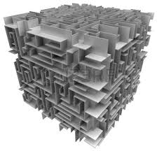
What is The Cube?
Labyrinth in 3D Cube
Category
  IT quiz
  Movie quiz
  Science quiz
Moving in The Cube

Slide 3
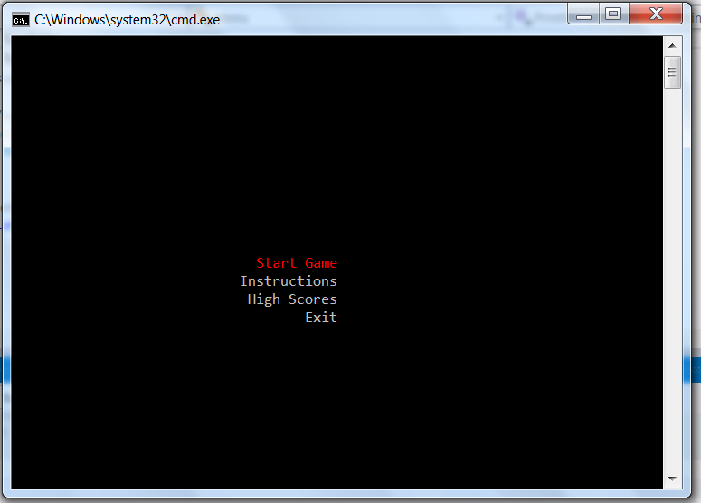
Where to see The Cube?
https://github.com/nencho83/CyclopsKing

Slide 4
Game Structure
Main Menu
Cube generation
Player
Challenge
Scores
Utility Class

